Slide 1
Livelock and Domino Effects
Dr. Lokeswari YV
ASP/ CSE
SSN College of Engineering

Slide 2
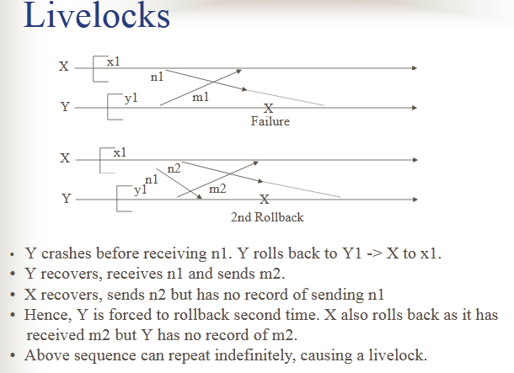
Livelocks due to delayed messages

Slide 3
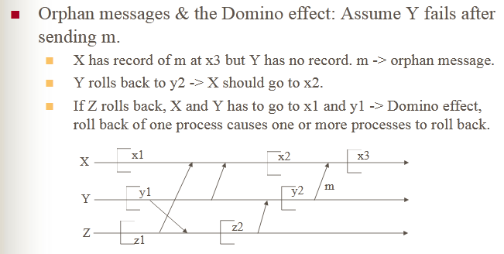
Domino Effect due to Orphan Messages

